Slide 1
Member Survey Results 2022

Slide 2
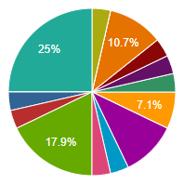
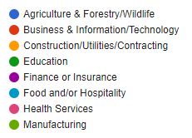
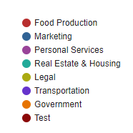
Industries represented in survey

Slide 3
Rating LADCO as an organization

Slide 4
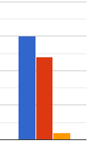
Rating LADCO’s programs and services
Communication with businesses and developers
Communication with members and partners
Technical assistance to businesses and developers
Marketing of the La Crosse area
Educational events, programs, and networking opportunities
Research about our local economy
Financing tools, revolving loan funds and incentives to assist businesses and development projects

Slide 5
Focusing LADCO’s services Participants chose top 3 choices
Help existing businesses stay in the area and grow their business here
Attract new businesses to the area
Assist businesses with automation, technology, and process improvement to address workforce challenges
Better manage the Coulee Region Business Center to raise awareness of the facility, its programs, and services
Assist startup businesses with financing, technical assistance, and real estate opportunities
Assist businesses with attracting more workers, development and training, and work-life balance
Facilitate more collaboration, regional partnerships, and regional solutions to our challenges
Purchase and redevelop vacant big-box stores or other difficult to develop sites
Facilitate more community development and quality of life projects (housing, parks and open space, etc.)

Slide 6
Current issues and future trends of concern Participants chose top 3 choices
Inflation and rising prices
Disruptions in the supply chain
Emergence of cryptocurrency
Lack of workers
Cost of training workers
Taxes and fees
Government regulations
Health pandemics
Cost of healthcare
Help with digitization
Housing

